Slide 1
Standard User – Search the Repository, Organize Contracts Using Personal Folders
February, 2013

Slide 2

Learning Objectives
Upon completion of this course you will be able to:
Perform a simple criteria search
Perform a search using multiple criteria
Save and Retrieve a Search
Use Additional Search options
Search for a contract using a Term value
Perform an Advanced Keyword Search
Organize Contracts using Personal Folders

Slide 3
Contract Searching Overview
The standard and advanced search criteria are very detailed.
The user has the ability to search using any of the user-defined Term values.
The Contract Search functionality in ECM is a dynamic feature that lets you:
  Configure your own search criteria from a range of fields available,
  Save the search configuration,
  Save the search criteria that you have specified,
  View your contracts based on folders or contract type, and
  Export search results and perform many more activities.

Slide 4
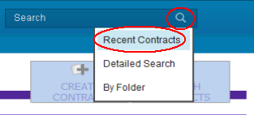
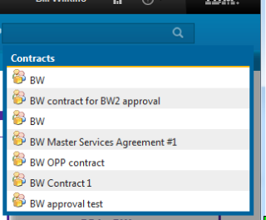
Accessing the Repository
Click the Quick Search icon ( ) on the Home page top menu to display the Search menu.
There are several ways to search the Repository for contracts.
To search for your recent contracts ,
select the Recent Contracts menu option
from the drop down menu.
This displays the up to 10 most recent contracts
you have accessed.

Slide 5
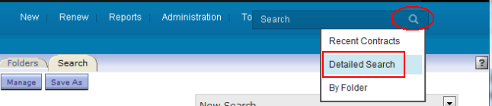
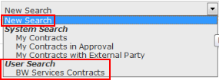
Accessing the Repository, cont.
To search all of the contracts in the repository, click the Detailed Search menu option. The Search tab is displayed.
From the Search drop down menu, select the New Search option.
(If the user has saved any searches for his/her own use, they are listed on the above drop down menu, under “User Search”, and can be run from there. More later on saving searches. For now we continue with a New Search.)

Slide 6
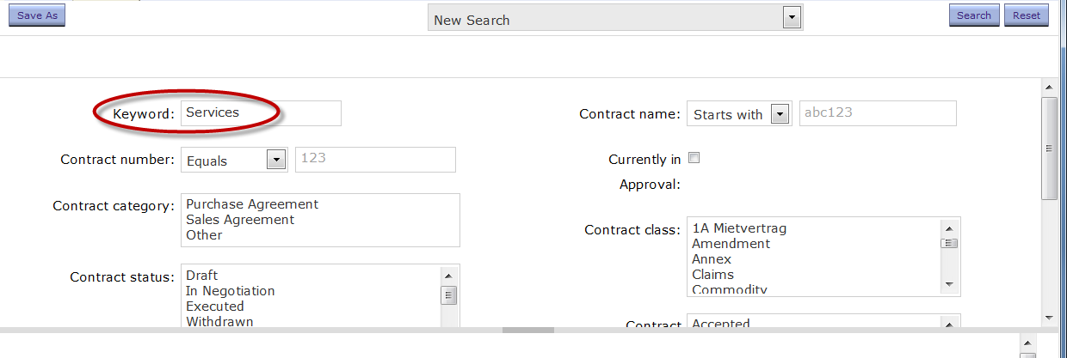
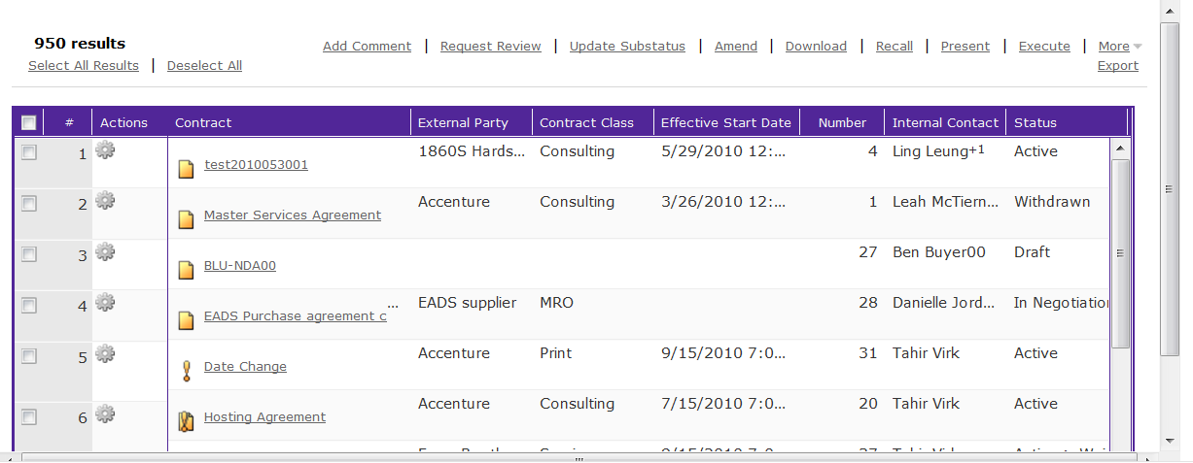
Search Repository – Dialog Box
The Criteria dialog box contains several fields of search criteria. You can enter values, select from drop down menus, or use the Select icon to select other criteria values.
To initiate a simple (one criteria) search:
  In the Keyword field, we entered “Services”; click the Search button.
  The list of contracts is displayed in the bottom pane of the window.

Slide 7
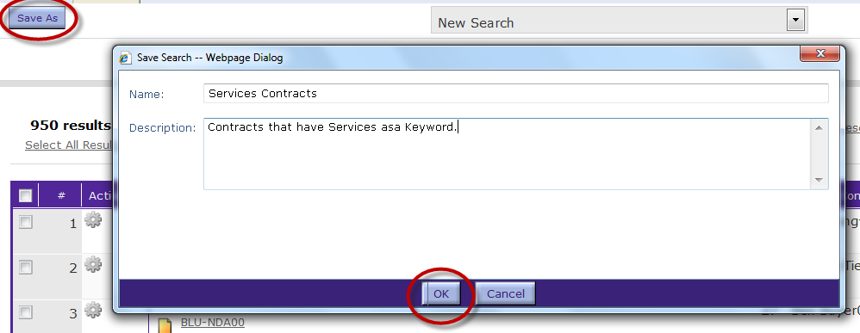
Save Search Criteria
To save this search for later use:
  (You can save up to 20 searches; they are only available to the same user)
  Click the Save As button to save this search for future use.
    The Save As dialog box is displayed.
  Enter a Name and Description for the search.
  Click OK when done.

Slide 8

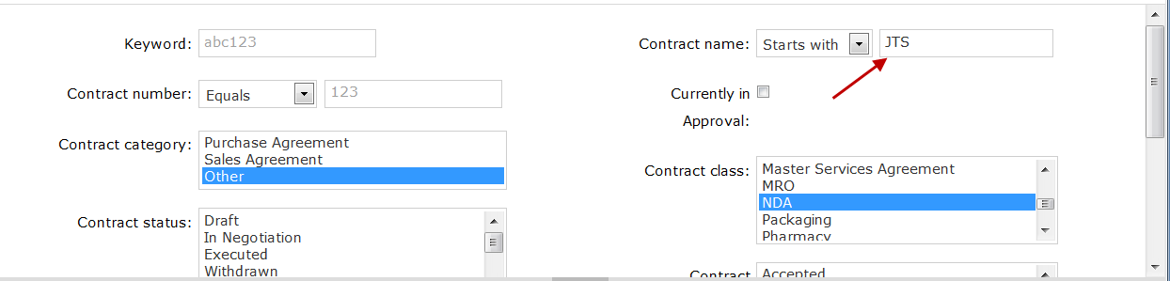
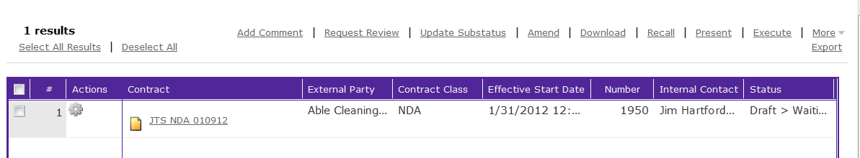
Search with Multiple Criteria
To start a different search, click the Reset button at the far right of the window.
To help narrow your search, you can enter multiple search criteria. For this example:
  Contract Name field: Example: Enter ‘JTS’
  Contract Category: Select Other from the drop down menu
  Contract Class: Select NDA from the drop down menu
  Click the Search button when done. The results are displayed at the bottom of the window.
Notes:
NOTE: For our test system, only SALES AGREEMENT works

Slide 9
Exercise: Search with Multiple Criteria
Before performing another search, you should clear all of the search criteria.
  Click the Reset button to clear all values from all of the fields.
For the search on the next slide, we are looking for all contracts still in Draft status that had an Effective Start Date after January 1, 2012, and an Effective End Date after January 1, 2014.
Note: You can enter the dates directly, or select the date values using the Calendar icons next to each field.

Slide 10
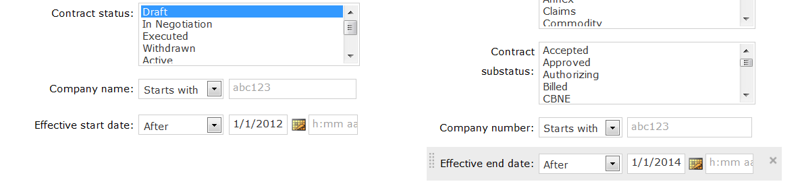
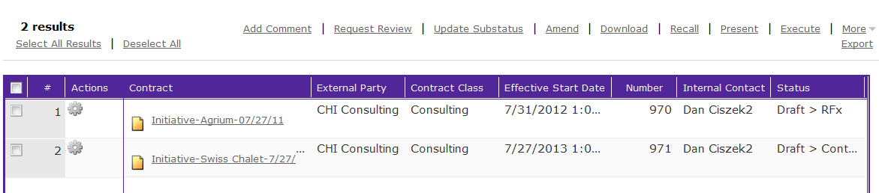
Exercise: Search with Multiple Criteria
The results for this example appear below.

Slide 11

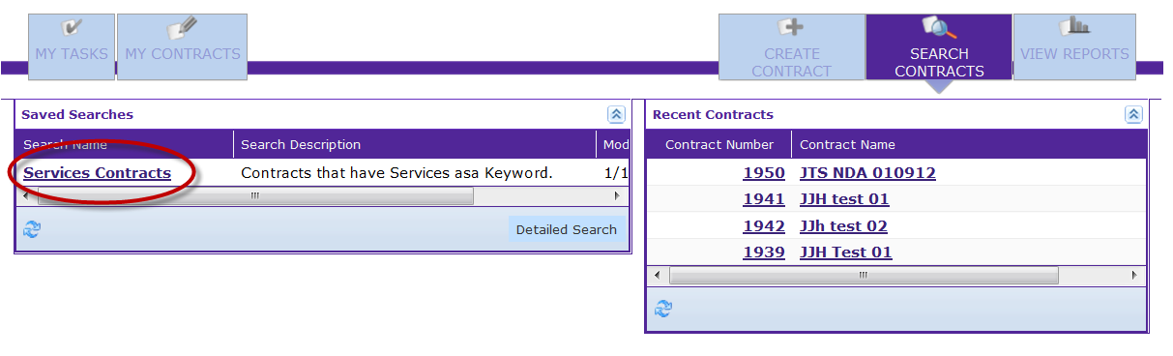
Retrieve a Saved Search
Click the Search Contracts button on the Home Page
The Saved Searches are displayed in the left pane
Click the hyperlink for a Search name.
The Search is performed and the results are displayed.
Use the Open Criteria (downward triangle) and Close Criteria (upward triangle) icons in the bar above the results display to reveal or hide search criteria.

Slide 12
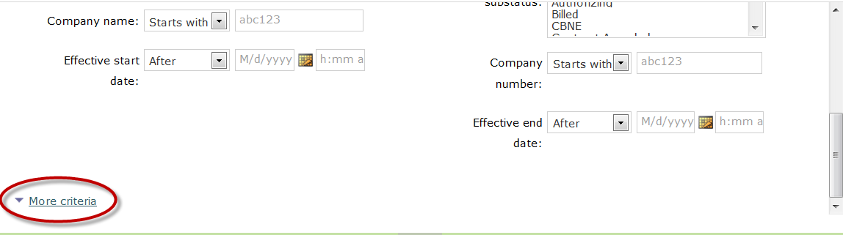
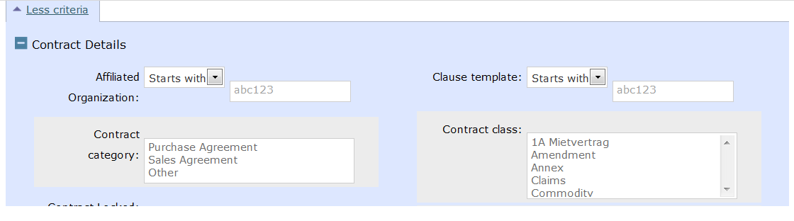
Additional Search Options
The Criteria pane of the Search form displays the standard search fields; however, additional search options are available.
Scroll to the bottom of the Criteria panel.
Click the More Criteria hyperlink. The Criteria panel expands to display additional search fields.
Scroll down to view additional criteria fields.

Slide 13
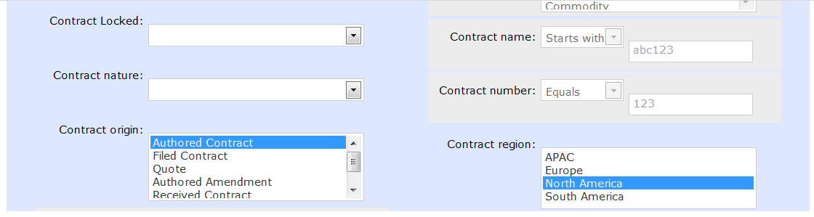
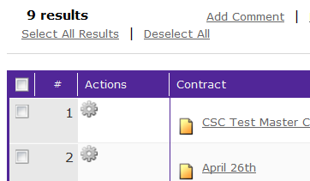
Additional Search Options, cont.
For this example, we will search for Authored Contracts in Draft status with a Region value of “North America”. (Searching on Status is particularly useful.) We select the values and click the Search button.
The results are displayed:

Slide 14
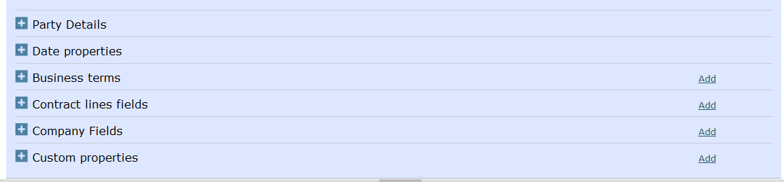
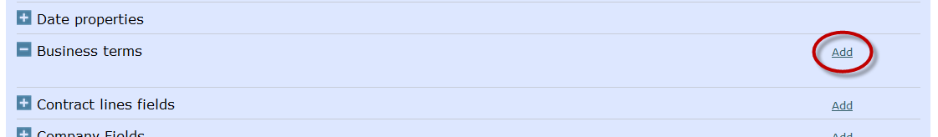
Additional Criteria
Scroll down further in the list to display additional criteria. At the bottom of the list are several fields where you can select other contract information to use as your criteria.
For this example, we will select a Term to use as criteria and search for specific Term values.
Click the small plus icon for the Business Terms field. The field expands to allow you to select the Terms.
Click the Add button to search for and select the Terms to search on.

Slide 15
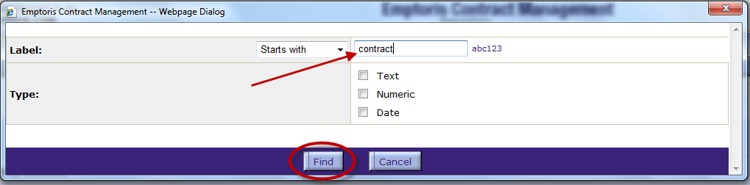
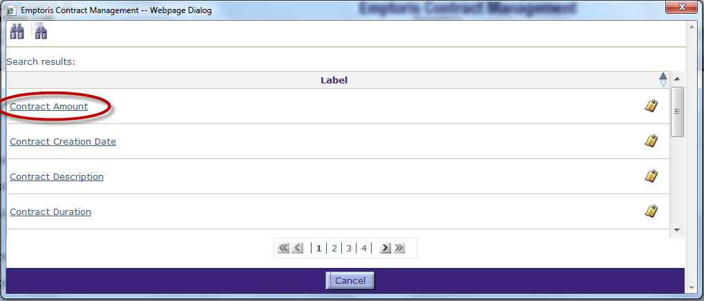
Additional Criteria, cont.
To use a pre-defined Term to conduct a search:
  Enter a Label or partial label for the Term.
  Select the Type to narrow the search to a specific data type.
  Click the Find button.
Navigate to the page that contains the Term.
Click the hyperlink for the name of the Term. Click the small clipboard icon to display the Term Properties. For this example, we select the Contract Amount Term.

Slide 16
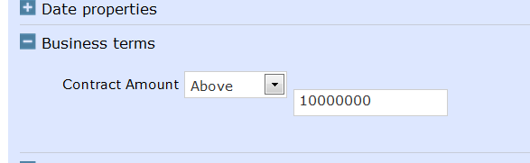
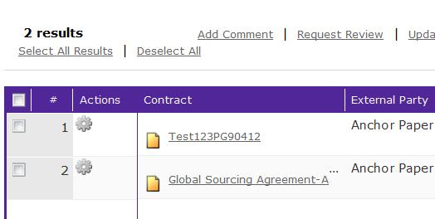
Search using Term Value
The Term name is entered as a Search field.
Select the “limits” for the value. For this example we select “Above”.
Enter the Value in the field. For this example, we are searching for all contracts over $10 Million.
Click Search.
The list of contracts meeting our Term value criterion is displayed.

Slide 17
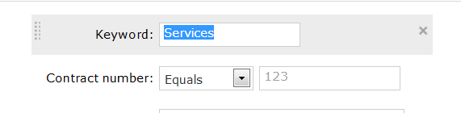
Advanced Keyword Search
You may search the repository using a Keyword search. Keyword searches are based on an index that is periodically updated, from the extracted content of contracts and attachments. The index does not include Term names or values.
Keyword Search supports the following features:
  Wildcard Searches: Single character wildcard search using "?" and multiple character wildcards using "*".
  Fuzzy Search: Similar rhythmic terms search using the term with the tilde "~".
  Boolean Operators: AND, OR, and NOT operators can be used for search.
  Keyword Grouping: Searches such as "(Illinois OR Indiana) AND United States"
  Escaping Special Characters: To escape any special character (+ - && || ! ( ) { } [ ] ^ " ~ * ? : \), use the "\" before the character.
  Note: If you search using the Keyword field, it automatically searches all attachments. The document types supported are – MS Word, text, PDF, and Excel. (Note: PDF documents must be OCR capable.)

Slide 18
Operations Against Search Results
Once you have a search result (a list of contracts), many operations are possible.
You start by selecting contracts by checking the box beside them. Or you can select all contracts in the list by checking the box at the top.
The following can be done by clicking on the appropriate link (some are under “More”). The operations take place immediately and with the same input; e.g., for Add Comment, the comment you add in the Comments dialog is added to all of the selected contracts.
  Add Comment
  Request Review
  Update Substatus
  Amend
  Download
  Recall
  Present
  Execute
  Change Primary Internal Contact
  Delete
  Unlock
  Add to Folder
  Export (the list of contracts to a spreadsheet)

Slide 19
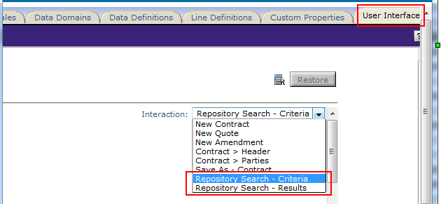
Tailoring Search
(This is really an Administration topic, but included here as specific to Search.)
Through Administration > Configuration > User Interface, you can tailor searching in two different ways (at an Organization level):
  Search Criteria: You can hide properties that are not being used in a particular implementation, to eliminate them as search criteria and simplify the user experience.
  Search Results: You can change the contract properties that appear in search results, and their sequence.

Slide 20
Organize Contracts Using Personal Folders

Slide 21
Use of Personal Folders
Personal Folders help to organize the contracts you work with.
  However, much of the motivation for using folders was to compensate for slow repository searches in previous releases, so there is much less reason to use folders now
  Contracts are placed in folders based on template configuration and group permission settings.
  Folders allow contract organization based on any parameter; e.g., project, location, BU, etc.
From the Home Page, click the Search Contracts button.
Click the Detailed Search button.

Slide 22
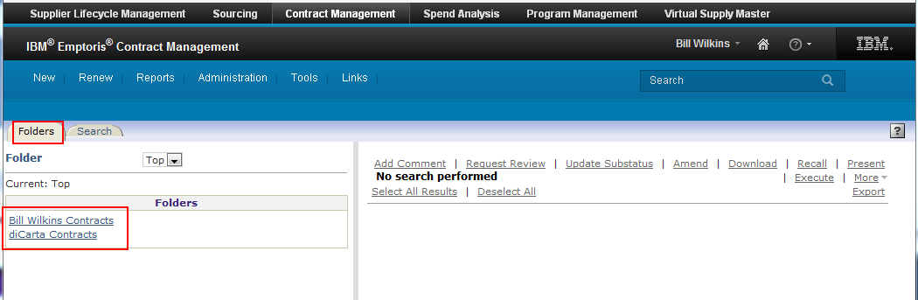
Folders tab
From the Detailed Search page, click the Folders tab.
Click the hyperlink for your contracts.

Slide 23
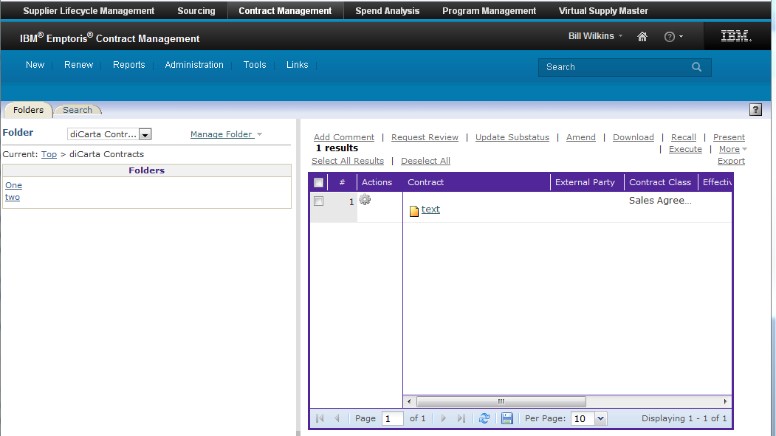
Folders tab, cont.
Contracts that have been assigned to you (based on permissions and group settings) are displayed here.
Subfolders of the current folder that are assigned to you are also displayed.

Slide 24
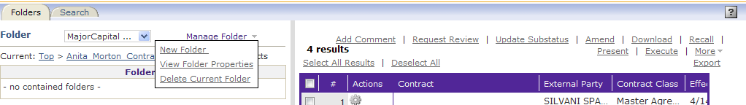
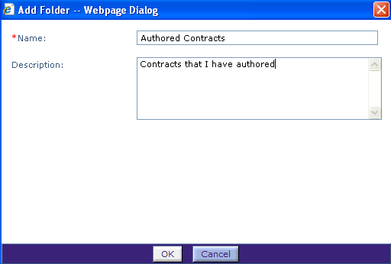
Manage Folders
Click the Manage Folder drop down to open a menu of options:
  Create a New Folder
  View Folder Properties
  Delete Current Folder (if authorized)
Click the New Folder link
Enter a Name for the folder and
provide a description, if desired
Click OK

Slide 25
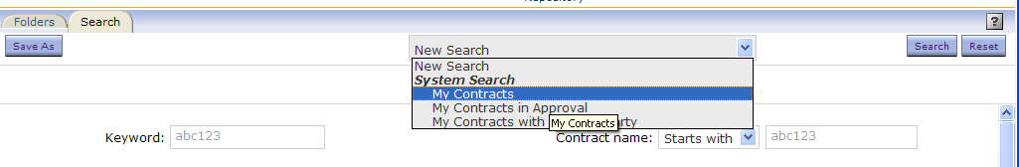
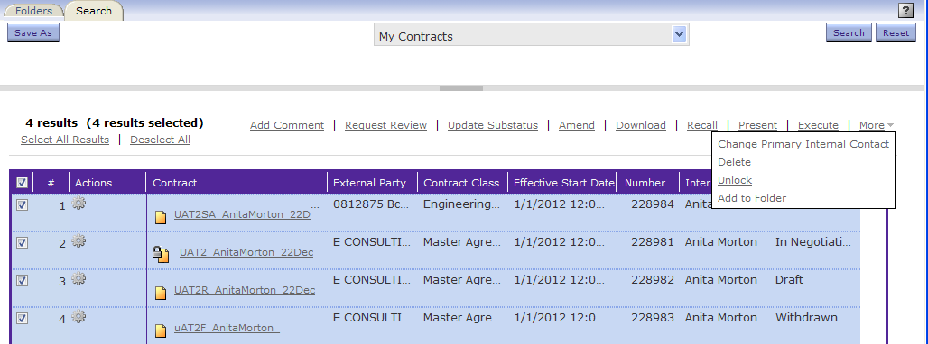
Add Contracts to a Folder
To add Contracts to this new folder, click the Search tab
  For this example: From the Search drop down, select My Contracts
From the list of contracts, select the contracts to be added
From the More drop down list, select Add to Folder

Slide 26
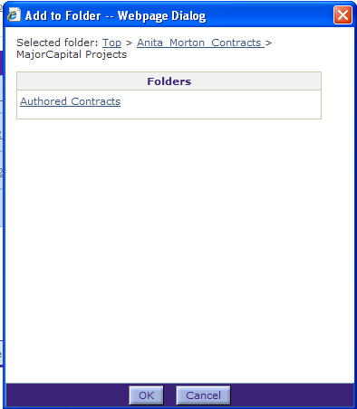
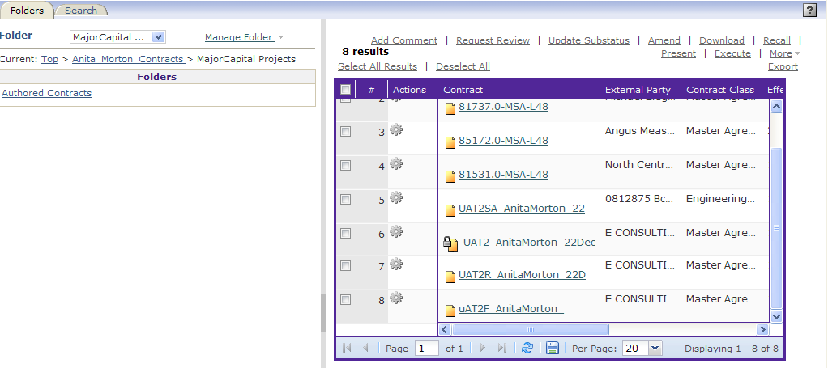
Add Contracts to a Folder, cont.
The Add to Folder dialog box opens.
Navigate (by clicking the links) to the folder name where
you want to add contracts
Click OK
Click the Folders tab and follow the bread crumbs; click
the folder to confirm that the contracts have been added

Slide 27
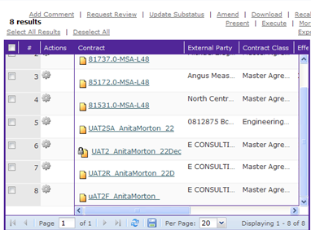
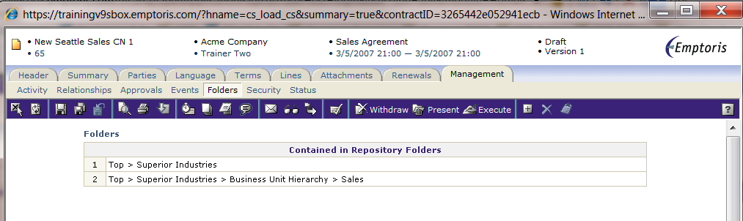
View Contracts Contained in Folders
Contracts can be added to more than one folder
To confirm which folder(s) a contract is in, click the contract name link
This opens the contract in the Header tab
Click the Management tab
Click the Folders sub-tab
  You can see that the contract resides in two different folders within the Repository
Notes:
More information about the Management tab is provided in later moduels

Slide 28

Questions?

